Slide 1
Contrast in complex images
By Xuhong Cao

Slide 2
Introduction
What is contrast?
How to define it?

Slide 3
Introduction
What is contrast?
Variance
Spatial frequency. (luminance change)
Human sensory systems (vision, audition, olfaction, taste, touch, temperature) :organized to respond strongly to temporal and spatial changes in the physical power of the stimulus.
Notes:
The variety of popular statistics for luminance contrast mostly reflects the fact that the adaptation state of the eye is affected differently by different kinds of stimulus pattern.

Slide 4
Introduction
Definition of contrast in simple patterns
Weber Contrast
Used for patterns: small, sharp-edged graphic objects like symbols and text characters on larger uniform backgrounds.
background is lighter than the symbol CW: negative(0 to – 1); background is darker than the symbol CW: positive(0 to ~~).

Slide 5
Introduction
Michelson Contrast
For simple periodic patterns (e.g., textures) there is no large area of uniform luminance that dominates the user's brightness adaptation. There is no clear choice for the denominator of the above statistics .
Equation:

Slide 6
Definition of Contrast in images

Slide 7
One common way(root mean square contrast)
With this definition, images of different human faces have the same contrast if their rms contrast is equal. 9 The rms contrast does not depend on spatial frequency content of the image or the spatial distribution of contrast in the image.
Xi: It’s a gray value of some point

Slide 8
Local Contrast
The local nature of contrast changes across an image and spatial frequency content are related and should be considered together.
I: Background luminance
Global contrast v.s Local contrast

Slide 9
Global Contrast v.s Local Contrast

Slide 10
Band-Limited Contrast
This definition was applied globally to the whole image as well as to one-quarter or one-sixteenth subimages in nonoverlapping windows.
A(u,v) : Amplitude of the Fourier transform of the image
DC: the zero frequency component.

Slide 11
New definition: Local band-limited contrast
Since human contrast sensitivity is highly dependent on spatial frequency, especially at threshold, contrast for each spatial frequency band is calculated separately.
f (x, y): the original image
g (x, y): inverse Fourier transform of the band-pass filter transform G(r)
l (x, y): luminance of the point

Slide 12
New definition: Local band-limited contrast
Left column: Bandpass amplitude image
Right column: Local band-limited contrast image
Top: 16 cycles per picture
Down: 32 cycles per picture

Slide 13
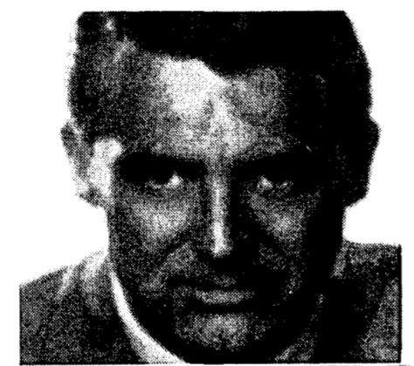
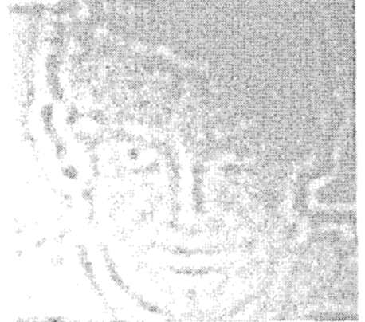
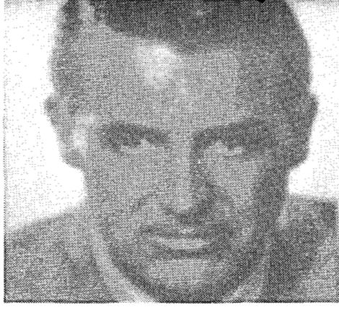
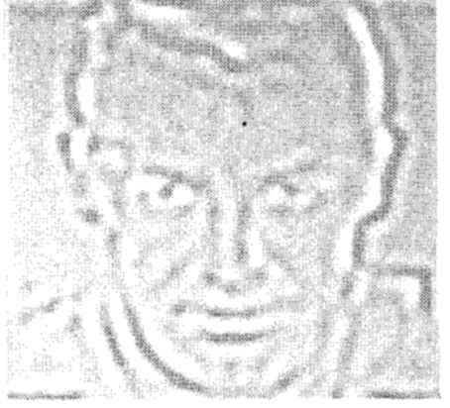
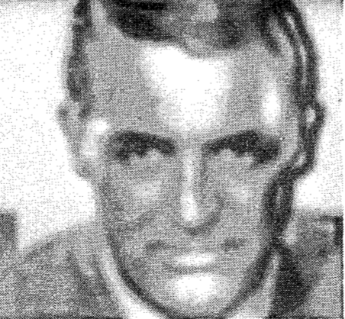
New definition: Local band-limited contrast
Bandpass amplitude image
Reconstructed image
Local band-limited contrast image
Reconstructed image

Slide 14


New definition: Local band-limited contrast
High contrast
original
Local band-limited contrast
example

Slide 15
Conclusion
Contrast in simple patterns
Contrast in images
New definition in contrast
Local contrast enhancement

Slide 16
Thanks!
Any questions?

